Slide 1
Tournament management system
Presenting by :
Azizur Rahman Maruf
B.Sc (engineering) in CSE
Level : 2 Semester : II
Student ID : 1902029
Md Iftekhar Hossain Tushar
B.Sc (engineering) in CSE
Level : 2 Semester : II
Student ID : 1902061
Sabbir Ahmed
B.Sc (engineering) in CSE
Level : 2 Semester : II
Student ID : 1902075

Slide 2
contents
Background Study
Methods and Packages
Results
Conclusion
References
Introduction
Objectives
Overview
Requirements
Architecture

Slide 3
Introduction
Tournament Management system for maintaining sports in a better and easier way . Traditionally when a tournament is organized storing and processing of data with paperwork is so difficult . For removing this drawbacks we developed this tournament management system for maintaining sports. This project is totally functionalized to organize teams for adding, editing, removing and so on. Teams data are managed in a good manner. We designed, developed and created database in part by part for handling this project. Our main goal is to solve this real life problem more functionally.

Slide 4
Objectives
Creating a tournament
Create new team and add to the table
Edit existing team from table
Delete existing team from table
Display standing table
Display teams in group
Managing team information

Slide 5
overview
Current system of tournament management is fully based on paper work and have to manage all records of teams and players on paper.
Paper work is a tedious job. There can be delay and the problem of human error in managing teams and providing resources.
Tournament Management System is able to automate the process of sports. It is useful for authorities which keep track of all the teams registered.
Performance, Efficiency, Control, Security etc are better than current system

Slide 6
requirements
Software Requirements
Operating System Windows 10
Front End Java, Java Swing
Back End MySQL
IDE Netbeans
Hardware Requirements
Desktop PC or a Laptop
Operating System – Windows 10
Intel® CoreTM i3-6006U CPU @ 2.00GHz
4.00 GB RAM
64-bit operating system, x64 based processor
1024 x 768 monitor resolution
Keyboard and Mouse

Slide 7
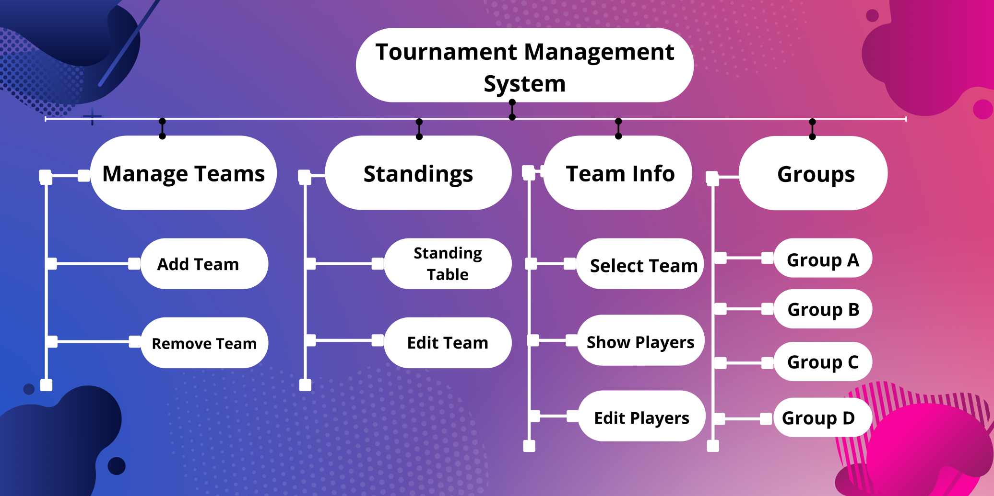
Architecture

Slide 8
Background study
Java
Java awt package
Java Swing package
Jframe form in Netbeans
MySQL with Workbench
Database query
Graphics using canva

Slide 9
Methods and packages
Awt package
AWTEvent management methods
Java Swing packages
JFrame
JPanel
Jlabel
Jbutton
JTextfield
Jtextarea
Jtable
JCombobox

Slide 10
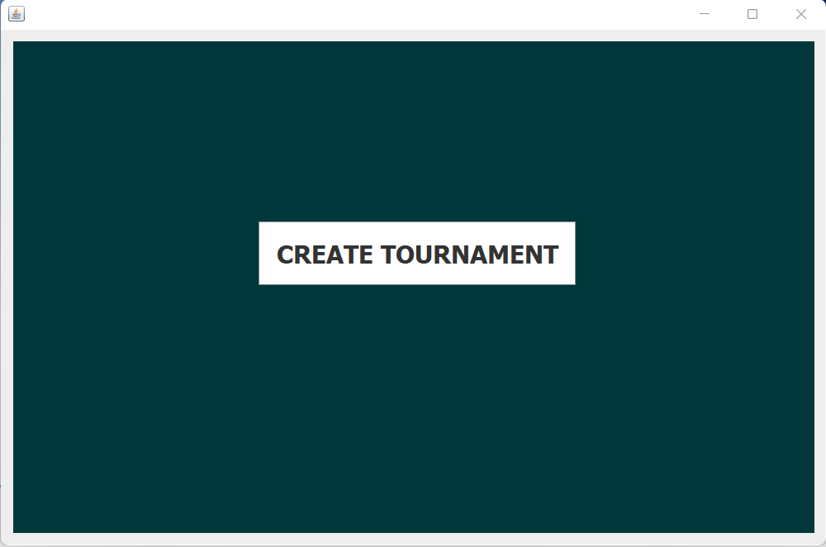
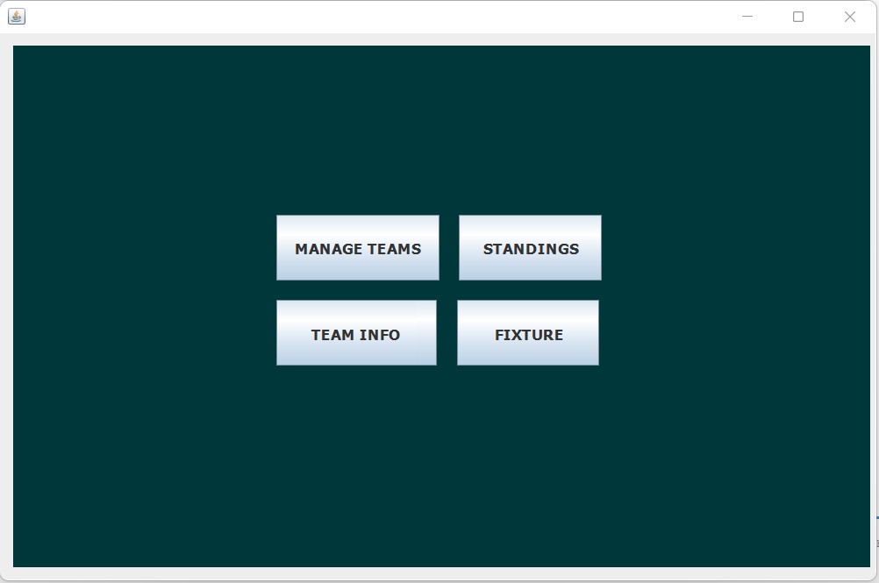
Results(intro)
First tab of “Tournament Management System” . After clicking “CREATE TOURNAMENT” it opens second tab with four button named “MANAGE TEAMS”, “STANDINGS”, “TEAM INFO”, “FIXTURE”.

Slide 11
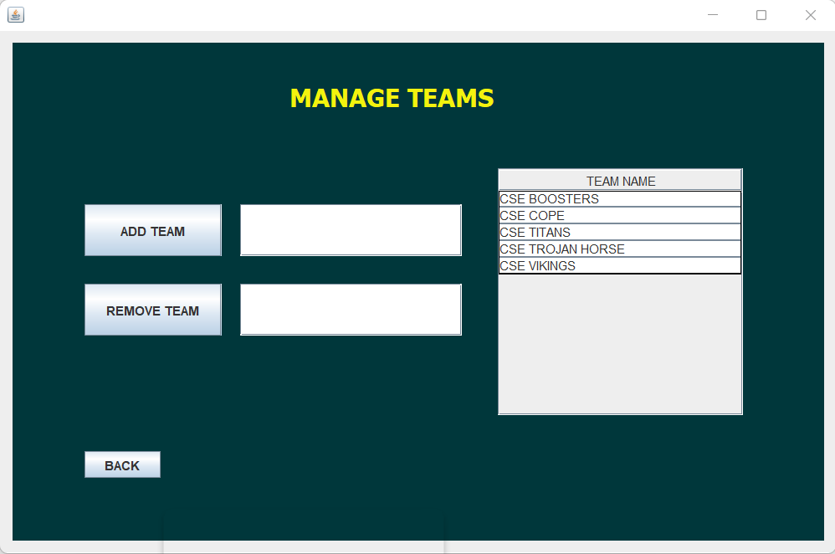

Results(Manage teams)
New team can be created by clicking “ADD TEAM” button after giving team name in besides text field

Slide 12
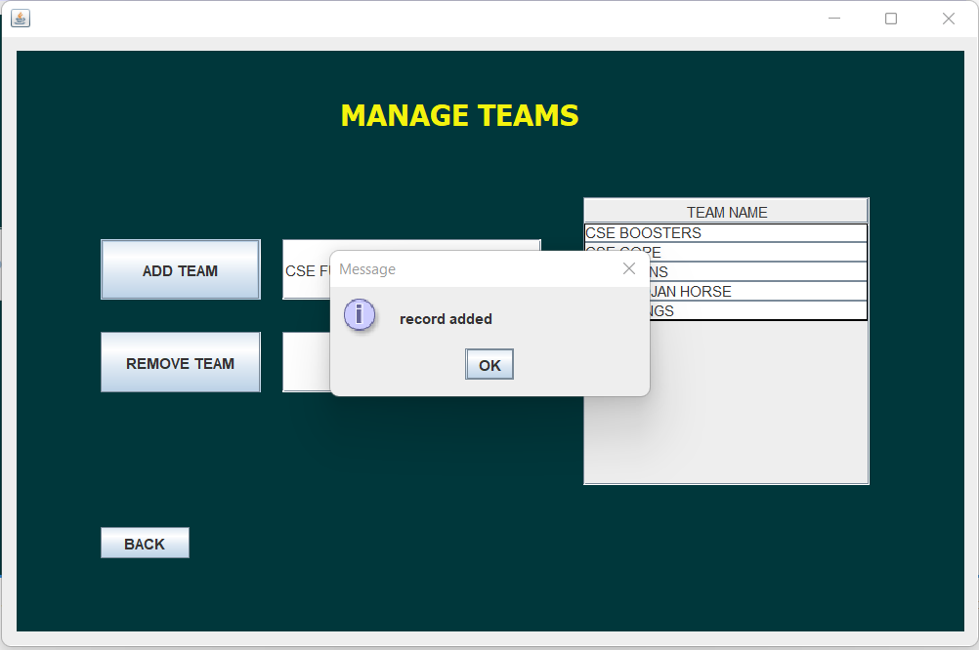
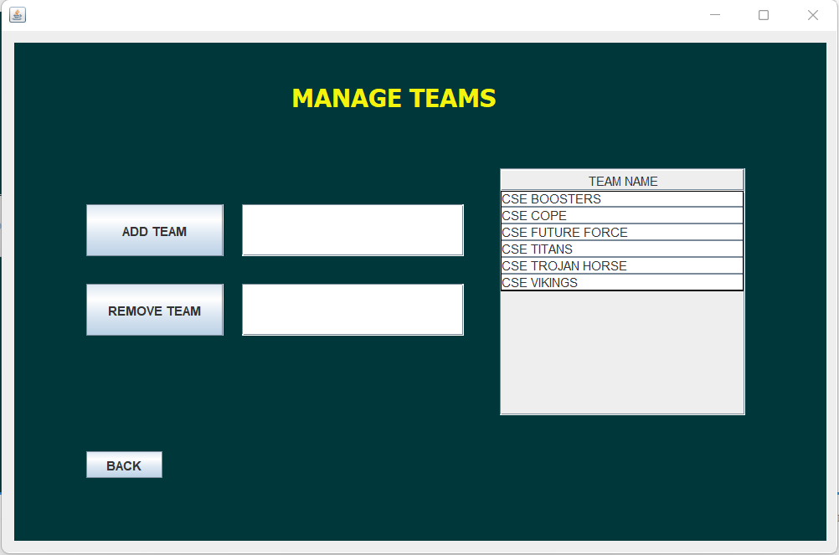
Results(Manage teams)
Team added confirmation in dialogue box and new row created for new team in “Team name” table

Slide 13


Results(Manage teams)
Selecting row of table named “TEAM NAME” for deleting a team . By clicking “REMOVE TEAM” button it deletes all data for that team from Database .

Slide 14
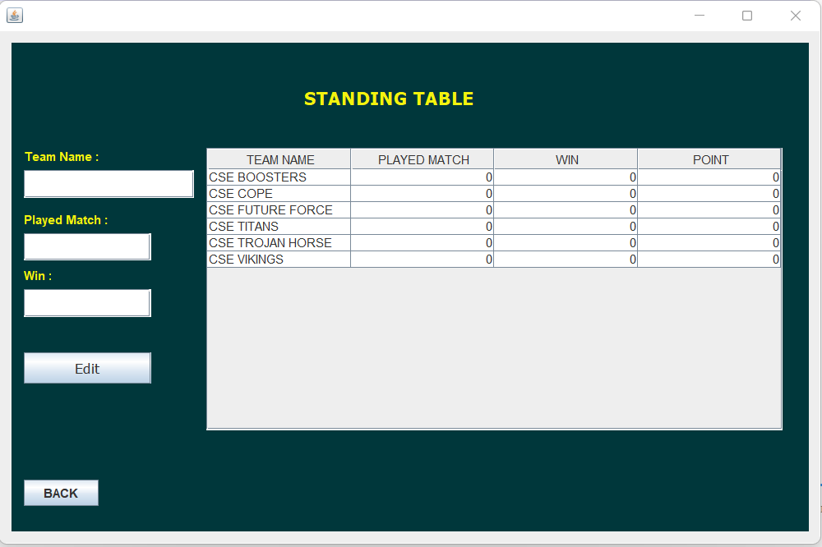
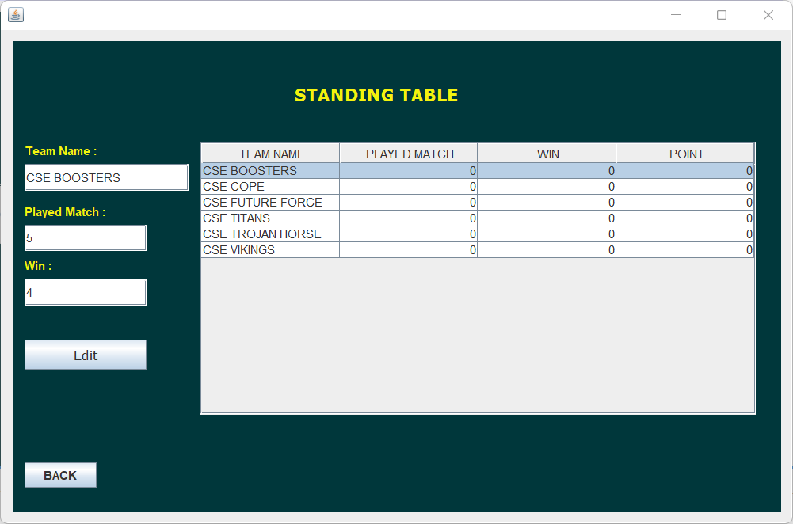
Results(Standings)
Selecting a row by clicking mouse of standing table, informations are fetched in proper text field labeled with “Team Name”, “Played Match”, “Win”.

Slide 15
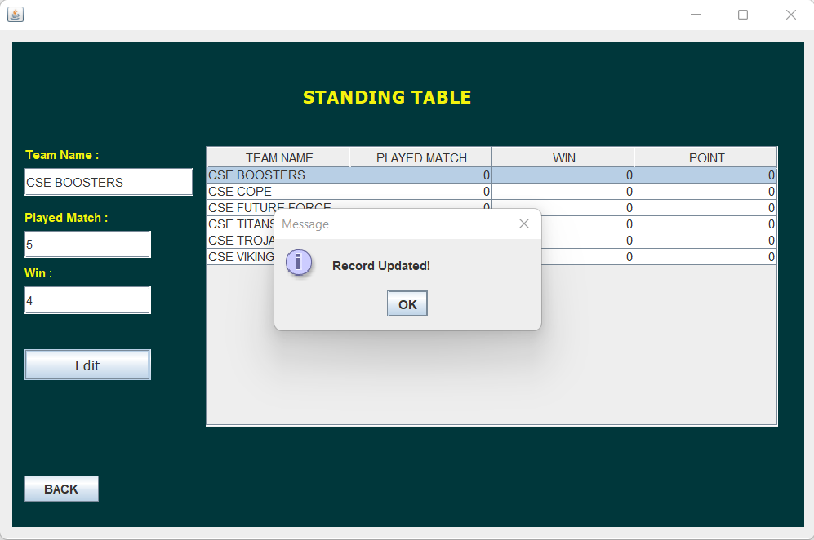

Results(Standings)
Informations in proper text field labeled with “Team Name”, “Played Match”, “Win” can be edited and after clicking “Edit” button information will be saved in Database as well as updates selected row of table in application tab.

Slide 16
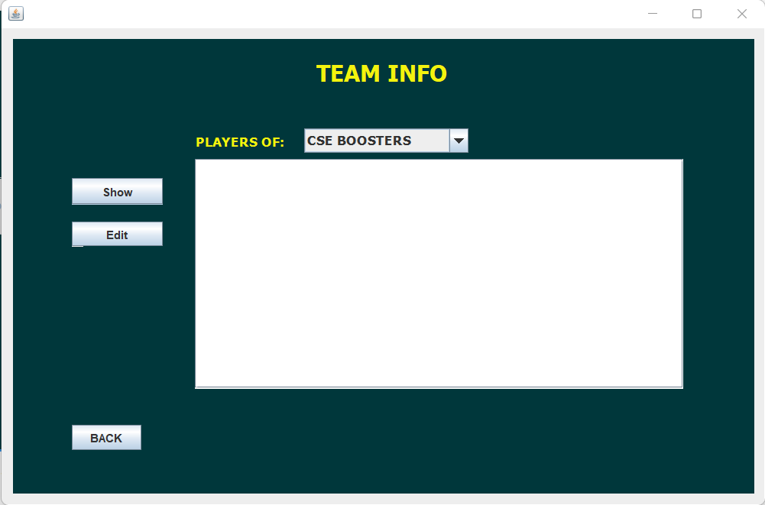
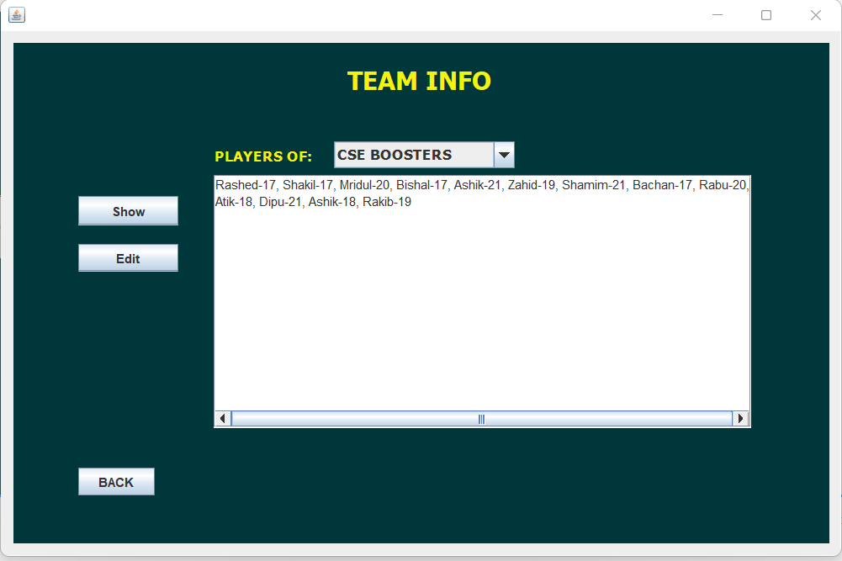
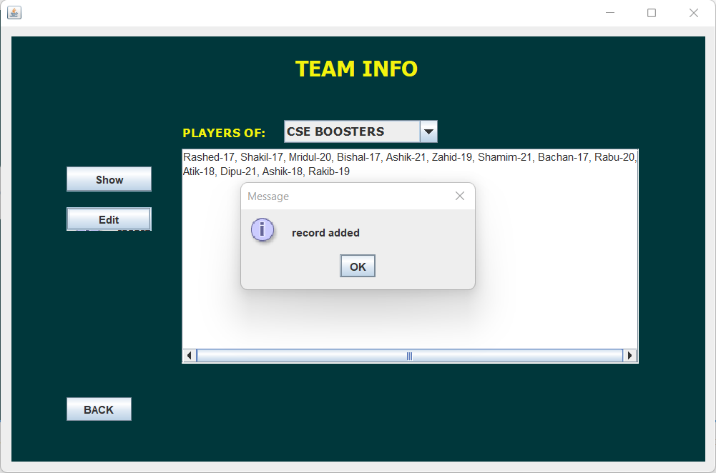
Results(team info)
Players name can be added typing in text area and then clicking “Edit” button and have opportunities to show saved players name for a specific team choosing from Combo Box .

Slide 17
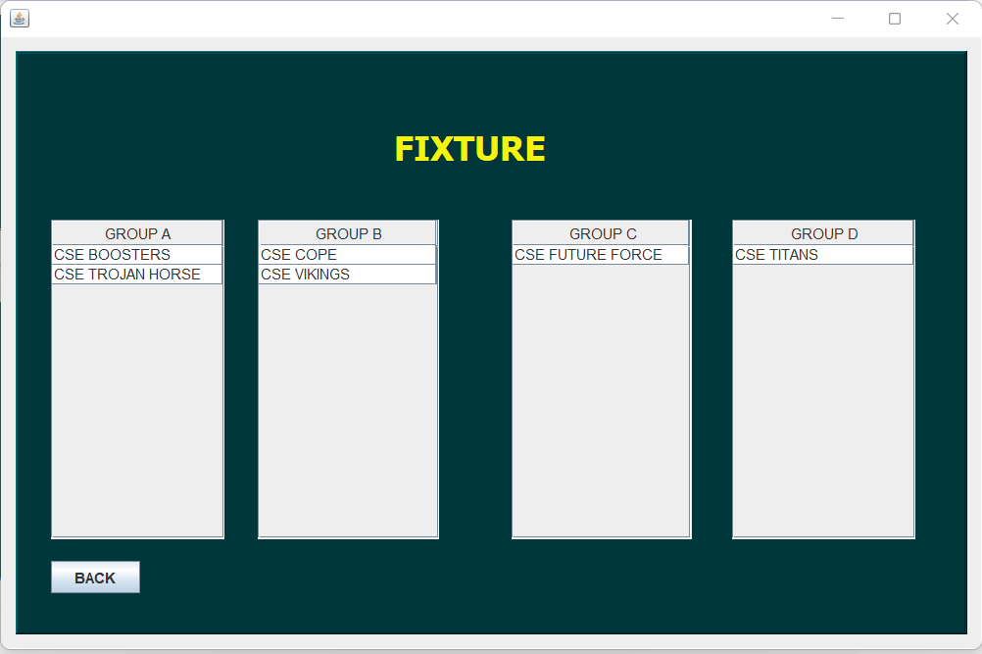
Results(fixture)
Teams sequentially added to groups named “GROUP A”, “GROUP B”, “GROUP C” and “GROUP D” when a team is created in “Manage Team” tab in application .

Slide 18
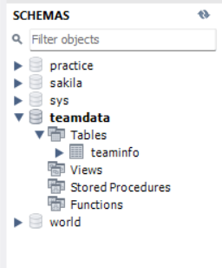
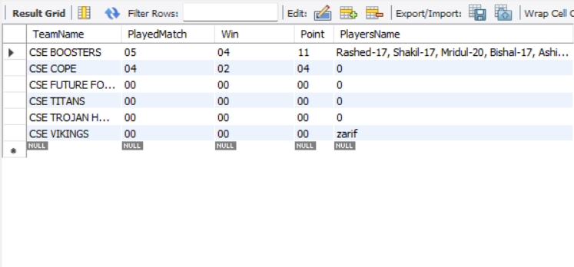
Results(Database)
Created Schema named “ teamdata” with five column for storing team name, played match, win, point, players name in MySQL Workbench for storing information .

Slide 19
Conclusion
Our main motive for creating, developing and building this project is to make the work easy for managing teams of a tournament. We applied various technologies and methods throughout this journey. This should be very useful and enjoyable as well. We faced so many difficulties to develop this project and our honorable mentor Hasi Saha mam helped us a lot. We learned new technologies, gained knowledge and applied them to complete this project. We will try to work on this project and will make this project more functional in near future.

Slide 20
reference
https://docs.oracle.com/en/java/
https://www.geeksforgeeks.org/java/
https://www.javatpoint.com/java-tutorial
Stackoverflow for various problems solution
https://www.w3schools.com/mySQl/default.asp
Google

Slide 21
Thank you

